Slide 1

Concussion Myth Busters
© 2023 CAZE CONCUSSION INSTITUTE LLC, All Rights Reserved

Slide 2
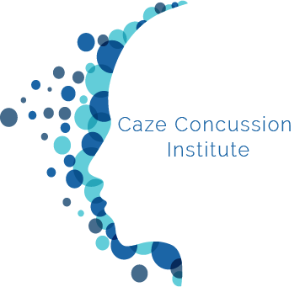
Learning Objectives
Explain the common network disruptions common after concussion
Identify the most common myths about concussion
Analyze recent research on the efficacy of minimum visits on concussion treatment with just a concussion specialist

Slide 3
Introduction
Thirty-three million children worldwide annually sustain a concussion (Davis et al. 2017)
Estimated yearly impact of $17 billion in health care costs (CDC, 2017)

Slide 4
Historically
Concussion was not considered a serious injury

Slide 5
Historically
Results:
  While other areas of medicine were advancing and creating specialists (i.e. elbow, shoulder, etc.), there have been a lack of concussion specialists
  While all other injuries have moved towards early intervention and treatment, concussion till recently has not
  There are currently less than 25 fellowship trained concussion specialists in the country and only 2 fellowships in the country that even offer this type of training

Slide 6
Professional Background- Dr. Caze
B.A. Adolescent Studies
M.A. Community Counseling and School Counseling
Ph.D. Clinical Psychology, concentration in sports neuropsychology
Residency at UCLA in adult neuropsychology
Fellowship at Children’s Health James Andrews Institute
Owner of Caze Concussion Institute

Slide 7
Professional Background (Research)
2020 Sports Neuropsychology Society Dissertation Award
2021 Pediatric Research in Sports Medicine Society Most Promising Career Award
Co-Authored Sports Neuropsychology Society Poster Award 2021
First to write a paper on tele-concussion (2021)
Written over 20 articles (and still writing!) on concussion

Slide 8
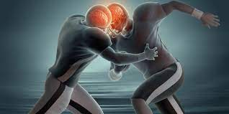
Sports as a Laboratory Assessment Model (SLAM)

Slide 9

Common Concussion Myths
Not easy to identify
Rest is best
Can just wait out
There is a magic number

Slide 10
What we know from SRC research
What is a concussion?
How is it measured?
How is it treated?

Slide 11
What we know from SRC research
What is a concussion?
How is it measured?
How is it treated?

Slide 12
Concussion= Network Disruption
Neurometabolic (Giza & Hovda, 2014; Gardner, Iverson, & Stanwell, 2014)
Axonal (Grossner, Mayer, & Hillary, 2019; Kontos & Collins, 2018)
Cerebrovascular (Shenton et al., 2012)
Autonomic (Leddy et al. 2016)
Ocular motor (Mucha et al., 2014)
Vestibular (Mucha et al. 2014)

Slide 13
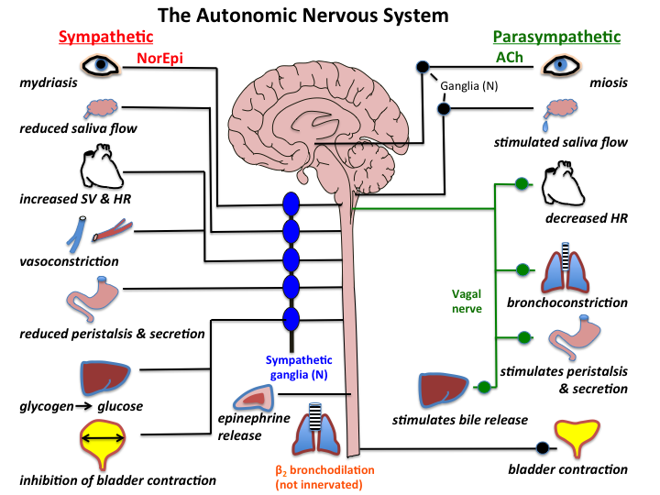
The Autonomic Nervous System

Slide 14
The Autonomic Nervous System
Regulates involuntary physiologic process including:
Heart Rate
Blood Pressure
Respiration
Digestion
Sexual Arousal

Slide 15

The Autonomic Nervous System
Fight/Flight/Freeze
Regulates Emotions
Image retrieved from https://dx35vtwkllhj9.cloudfront.net/universalstudios/cocaine-bear/images/regions/us/onesheet.jpg on 03/13/2023

Slide 16
Autonomic Nervous System
Common Symptoms reported include:
Fatigue
Sleep disturbance (too much or too little)
Exercise intolerance and/or symptoms are exacerbated with physical activity
Mood disturbance including an increase in irritability

Slide 17
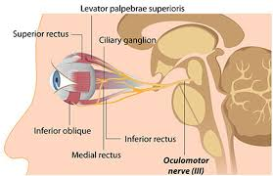
Ocular Motor System

Slide 18
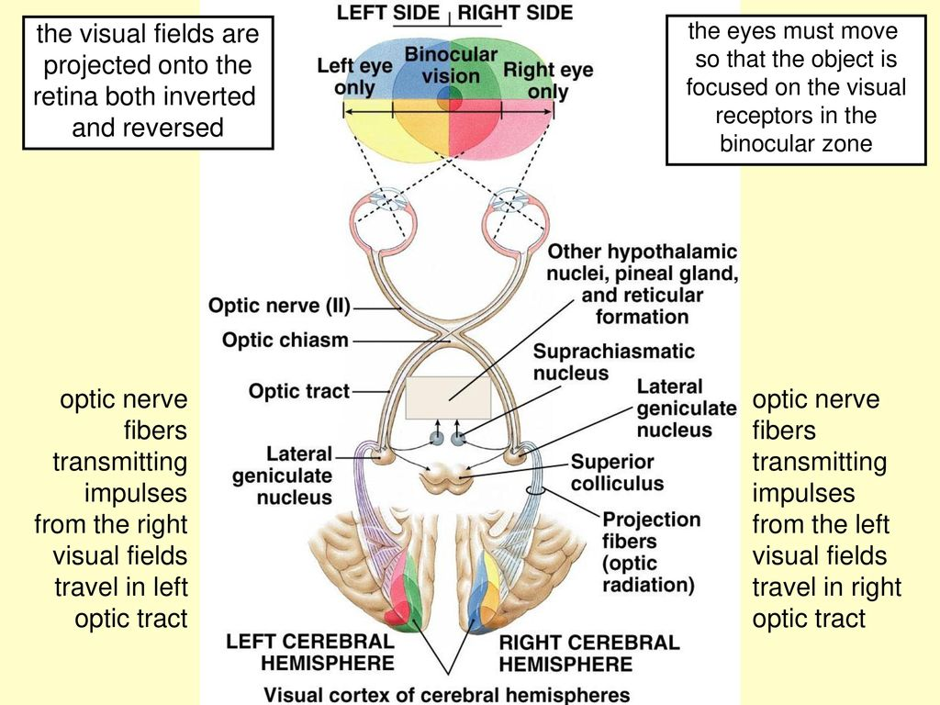
Ocular Motor System

Slide 19
Ocular Motor System
Common Symptoms reported include:
Blurred vision
Headache “pressure”- usually behind eyes
Photophobia
Fogginess

Slide 20
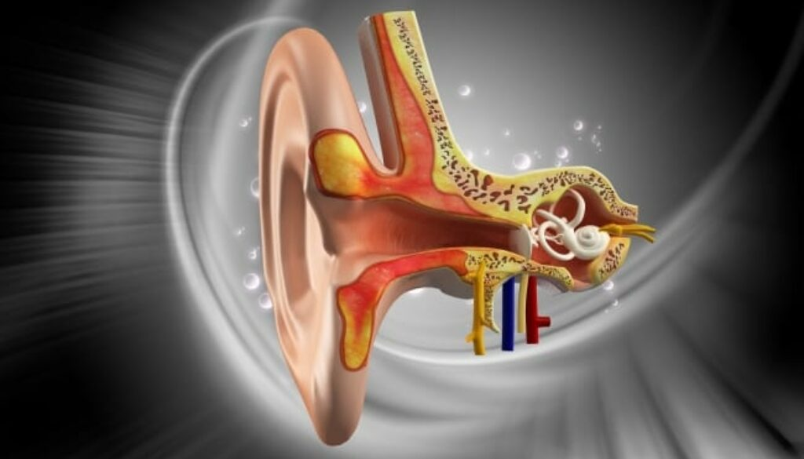
Vestibular

Slide 21
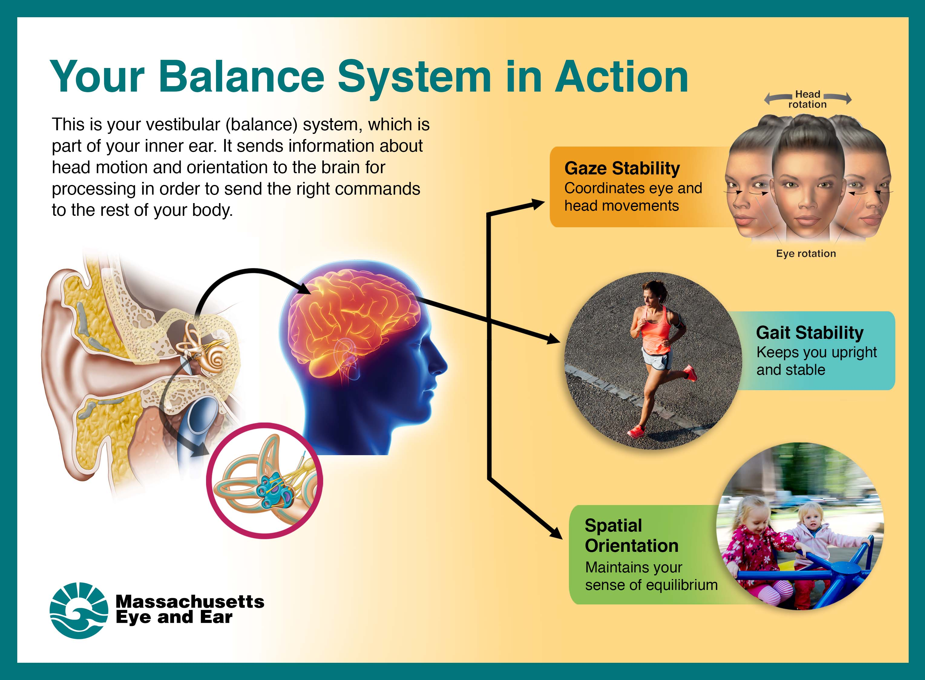
Vestibulo-ocular and Vestibulo-spinal

Slide 22
Vestibular
Common Symptoms reported include:
Dizziness
Nausea
Blurred vision
Balance problems
Feeling “foggy”

Slide 23
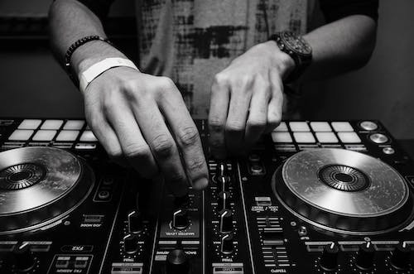
Modifiers
Neck
Anxiety
Sleep

Slide 24

Notes:
At that time, high school football had been around 150 years, why now was a law passed?

Slide 25
Legislation-Positives
We actually consider concussion an injury now
Rule changes have resulted in less concussions
We are slowly catching up with the rest of sports medicine in seeing fellowship trained specialists for this injury

Slide 26
Legislation-Unintended Consequences
Policies trump science
False sense of expertise
An update is too much work, so no need to review
Concussion Protocol is viewed as a death sentence by athletes

Slide 27
Only Injury with a State Law
What would be the aftermath if we had a state law around ACL?

Slide 28
What we know from SRC research
What is a concussion?
How is it measured?
How is it treated?

Slide 29
Most Common Assessment Tools
SCAT
Computerized testing (ImPACT)
Symptom Self-Report

Slide 30
SCAT-6
Currently the Sideline Concussion Assessment Tool- 6th Edition (SCAT-6) is recommended by the Concussion in Sport Group (CISG) for acute assessment of concussion.
The SCAT-6 is broken down into immediate or on-field assessment and the SCOAT for office or off-field assessment

Slide 31
SCAT: Limitations
Sensitivity and specificity is greatly reduced each subsequent day after injury
While it has been improved still no VOMS
Socio-cultural sidebar: over 60% of posters pulled before consensus meeting happened

Slide 32
ImPACT
Developed in response to Pittsburgh Steelers head coach wanting a more objective measure for his concussed athletes
Brief and more specific than anything else available at the time (1990s)

Slide 33
ImPACT: Limitations
No significant updates since it’s inception
Baseline testing is time consuming and often not necessary
Sensitivity and specificity is greatly reduced each subsequent day after injury

Slide 34
Self-report symptom scales
Often driver of clinical decisions:
  Acutely and removal from play
  Progression for return to play
  Often driver for determining clearance

Slide 35
Limits of Self-Report
Article: Caze, T., Vásquez, D., Moffatt, K., Waple, K., & Hope, D. (2021). A prospective pilot study of anxiety sensitivity and adolescent sports-related concussion. Archives of clinical neuropsychology, 36(6), 930-939.
Aim: This study examined the relationship of that anxiety sensitivity (AS) with the initial and ongoing symptoms reported by adolescents after sustaining a sports-related concussion (SRC).
Participants: 40 participants, age 13-18, 20 concussed patients were matched by age, gender, and race with musculoskeletal cotnrols
Outcome Measures: a﻿fter the initial clinic intake, participants completed an online survey at three-time points. Survey measures included the self-report graded symptom checklist and the AS Index-3. Researchers used growth curve analysis to examine the relationship between AS Index-3 scores with initial and ongoing symptom reporting over time.

Slide 36
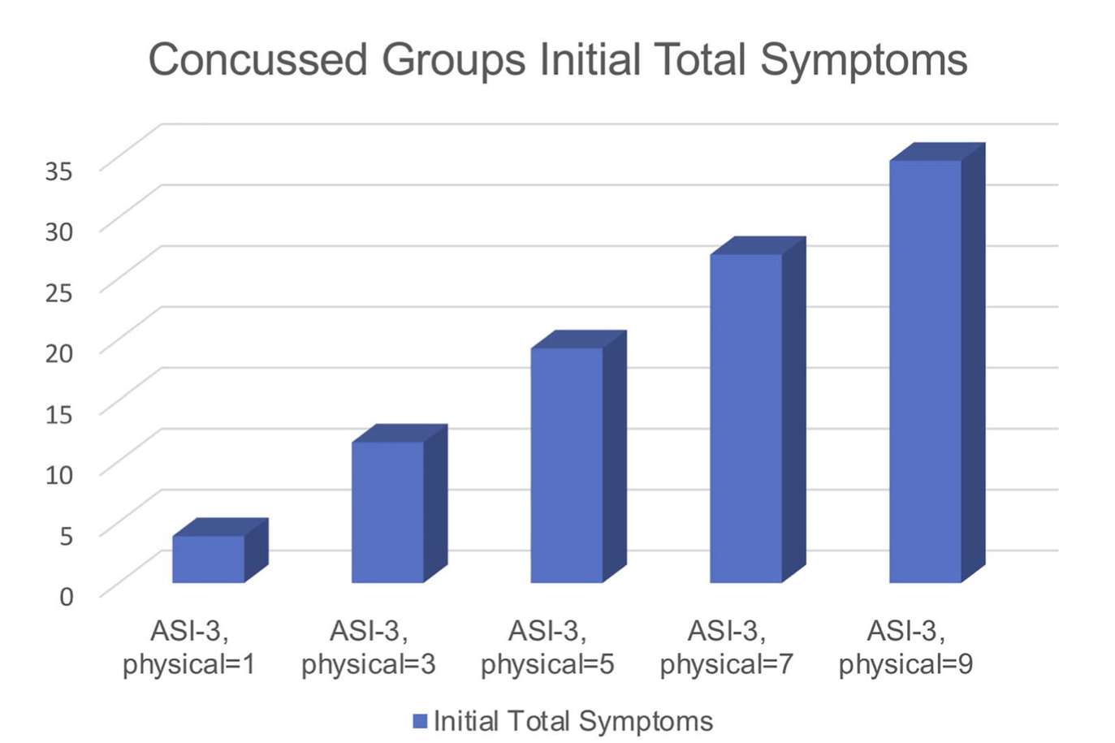
Limits of Self-Report

Slide 37

Personality/trait factors can influence self-reporting of symptoms, making it less reliable

Slide 38
Limits of Self-Report
One of the challenges when working with individuals with mTBI is that management of concussion is often driven by the self-report of symptoms (Collins et al., 2016), which is highly subjective and may be driven by factors other than the concussion injury.

Slide 39
Limits of Self-Report
A major limitation to the diagnosis of concussion being heavily reliant on self-report is that it can result in a high number of type I error (i.e. false positives). For example, in their study of 30,000 adolescent student athletes at baseline, Iverson et al., (2015) found that 20% of male participants and 28% of female participants at baseline reported enough symptoms to meet ICD-10 PCS symptom criteria.

Slide 40
Limits of Self-Report
Additionally, baseline samples of adolescents found only 36% did not report symptoms (Asken et al., 2017) and only 40% of collegiate athletes at baseline were asymptomatic (Asken et al., 2017)

Slide 41
Limits of Self-Report
This raises the question –After a few weeks, if minor symptoms persistent, what is related to the concussion and what is “normal degree of nonspecific symptomology” (McCrea et al., 2019, p.19).

Slide 42
Self-report symptom scales not specific
Few people are at zero symptoms
Giving daily could exacerbate recovery

Slide 43
The Vestibular Ocular Motor Screener
Vestibular/Ocular Motor Test: | Not Tested | Headache 0-10 | Dizziness 0-10 | Nausea 0-10 | Fogginess 0-10 | Comments
BASELINE SYMPTOMS: | N/A
Smooth Pursuits
Saccades – Horizontal
Saccades – Vertical
Convergence (Near Point) |  |  |  |  |  | (Near Point in cm): Measure 1: ______ Measure 2:______ Measure 3:______
VOR – Horizontal
VOR – Vertical
Visual Motion Sensitivity Test

Slide 44
Measurement/DX
Article: Mucha, A., Collins, M., Elbin, R.J., Furman, J., Troutman-Enseki, C., DeWolf, R., Marchetti, G., & Kontos, A. (2014). A brief vestibular/ocular motor screening assessment to evaluate concussions. The American Journal of Sports Medicine. 42 (10), 2479- 2586
Article: Kontos, A., Surfrinko, A., Elbin, R.J., Puskar, A., & Collins, M. (2016). Reliability and associated risk factors for performance on the vestibular/ocular motor screening (VOMS) tool in healthy collegiate athletes. The American Journal of Sports Medicine. 44 (6), 1400-1406
Article: Moran, R., Covassin, T., Elbin, R.J., Gould, D., & Nogle, S. (2018). Reliability and normative reference values for the vestibular/ocular motor screening (VOMS) in youth athletes. The American Journal of Sports Medicine. 46 (6), 1475-1980

Slide 45
Reliable
In it’s totality, really good at detecting concussion
Very low false positive rate- few youth or college students at baseline will have a positive VOMS

Slide 46

A more reliable snapshot

Slide 47
VOMS Neuro-correlates with work
Poor Smooth Pursuits- eyes will fatigue quickly, will either have increase in headache during high visual integration (i.e. police patrolling or dual screen tasks) or by end of the day.
Poor Saccades- screens will bother them, will often report lights in certain settings (i.e. florescent lights in open space cubicles) bothering them in addition to pressure headaches
Poor Convergence- meetings requiring note taking or constant reading will provoke symptoms
Poor VOR/VMS- will struggle with physical aspects of work (i.e. delivering mail or lifting heavy objects quickly)

Slide 48
What we know from SRC research
What is a concussion?
How is it measured?
How is it treated?

Slide 49
What works
Early Access to treatment
Early Exercise
Targeted interventions early and often
Step-wise progressions

Slide 50
Day Zero Research- A lesson from sports
Those who established specialty concussion care within 7 days improved faster than those who received care after 7 days (Eagle et al., 2020; Kontos et al.,2020).
Indeed, patients who delayed clinical care were about 6 times more likely to experience a prolonged recovery (i.e., greater than 30 days; Kontos et al., 2020).

Slide 51
Day Zero Research- A lesson from Sports
At the patient level, medical care costs are tied to length of recovery. SRC recovery for children and adolescents typically occurs within 30 days and costs families $800 per incident, but these costs may triple for recovery periods beyond 30 days (Sariaslan et al., 2016; Yengo-Kahn et al. 2020).

Slide 52
Day Zero Research- A lesson from Sports
Paper in press:
856 participants ages 12-18
DSI:
  Group 1: 48 hours or less (less than 2 days)
  Group 2: 49-96 hours (2-4 days)
  Group 3: 97-168 hours (5-7 days)
Results:
  Group 1: M=15 days, OR=3.23
  Group 2: M=18 days, OR=1.88
  Group 3: M=21 days

Slide 53
Day Zero Research- A lesson from Sports
Youth Hockey numbers:
Those seen in season (27/29) were cleared on average in 12 days.
Those who were seen first and only by CCI (24/29) and cleared by CCI on average were cleared on average in 8.6 days.
  Those not seen by CCI first 5/29 on average were cleared on average in 32.4 days
On average kids were cleared in 8.25 days after starting treatment at CCI
4/24 kids did not miss any games
An additional 13/24 only missed one game
17/24 (71%) missed one game or less

Slide 54
Days Since Injury- WC data
Pilot:
35 participants
  Age 14-65
  Insurance types: Commercial, Auto, WC

Slide 55
Days Since Injury- WC data
Results: As Age Increases so do:
  the physical therapy duration (r = .482, p < .01)
  number of PT visits (r = .462, p < .01)
  number of days to recover from initial neuropsychology exam (r = .431, p < .01)
  number of combined PT/Neuro visits (r = .446, p < .01).

Slide 56
Days Since Injury- WC data
Results: DSI
  Very high correlation with number of days to neuropsych exam and days to recovery (r = 1.0, p < .001).
  Multivariate General Linear Model Analysis
    When we examine the factors of sex, insurance type, days to a neuropsychology exam, and the interaction between sex* insurance, the only thing that consistently mattered was the number of days that it took to get to a neuropsych examination when it came to days to recovery (p < .001).
    The faster you get in then the faster that you recover.

Slide 57
Days Since Injury- WC data
Results: DSI
  ANOVA findings:
    Workers Comp folks get more neuropsych visits (3.8) compared to private insurance (2.62) with p < .019
    and more combined PT and neuropsych visits (17.27) compared to private insurance patients (10.77) with p < .014.
    In other words, workers comp patients are the most expensive with an average of 6 or so more visits per patient

Slide 58
Days Since Injury- WC data
Limitations:
  Small N
  Does not include few WC I’ve seen acutely and have gotten better with just HEP (yet)
  Does not include WC across all PTs (yet)

Slide 59
What works
Early Access to treatment
Early Exercise
Targeted interventions early and often
Step-wise progressions

Slide 60
Research
Article: Leddy, J. J., Baker, J. G., & Willer, B. (2016). Active rehabilitation of concussion and post-concussion syndrome. Physical Medicine and Rehabilitation Clinics, 27(2), 437-454.
Article: Leddy, J., Hinds, A., Sirica, D., & Willer, B. (2016). The role of controlled exercise in concussion management. PM&R, 8(3), S91-S100.
Article: Leddy, J. J., Haider, M. N., Ellis, M., & Willer, B. S. (2018). Exercise is medicine for concussion. Current sports medicine reports, 17(8), 262.
Article: Haider, M. N., Johnson, S. L., Mannix, R., Macfarlane, A. J., Constantino, D., Johnson, B. D., ... & Leddy, J. (2019). The buffalo concussion bike test for concussion assessment in adolescents. Sports health, 11(6), 492-497.

Slide 61
Research
Article: Haider, M. N., Bezherano, I., Wertheimer, A., Siddiqui, A. H., Horn, E. C., Willer, B. S., & Leddy, J. J. (2021). Exercise for sport-related concussion and persistent postconcussive symptoms. Sports health, 13(2), 154-160.
Article: Haider, M. N., Herget, L., Zafonte, R. D., Lamm, A. G., Wong, B. M., & Leddy, J. J. (2021). Rehabilitation of sport-related concussion. Clinics in sports medicine, 40(1), 93-109.
Article: Shen, X., Gao, B., Wang, Z., Yang, Y., Chen, Z., Yu, L., & Wang, Z. (2021). Therapeutic effect of aerobic exercise for adolescents after mild traumatic brain injury and sport-related concussion: a meta-analysis from randomized controlled trials. World Neurosurgery, 146, e22-e29.

Slide 62
Physical exercise accelerates recovery
Early intervention is most effective
Effective across ages and modalities (treadmill, bicycle)

Slide 63
Research
Article: Seehusen, C. N., Wilson, J. C., Walker, G. A., Reinking, S. E., & Howell, D. R. (2021). More physical activity after concussion is associated with faster return to play among adolescents. International journal of environmental research and public health, 18(14), 7373.
Article: Neely, L. M., Smulligan, K. L., Wingerson, M. J., Seehusen, C. N., Simon, S. L., Wilson, J. C., & Howell, D. R. (2022). The association between sleep and physical activity with persisting post‐concussion symptoms among adolescent athletes. PM&R..

Slide 64
More steps per day= faster recovery (8,158 vs 11,147)
More times exercising per week= faster recovery (2.9 vs 5)
More total minutes spent exercising= faster recovery (117 vs 261)
All the above= better sleep

Slide 65
Research- 2023 CISG Consensus
Article: Leddy JJ, Burma JS, Toomey CM, et al. Br J Sports Med 2023;57:762–770.
Article: Patricios JS, Schneider KJ, Dvorak J, et al. Br J Sports Med 2023;57:695–711.

Slide 66
Strong evidence exists regarding the benefits of physical activity and aerobic exercise treatment as early interventions
facilitates recovery and reduces the incidence of post-concussive symptoms persisting beyond 1month from injury

Slide 67
What works
Early Access to treatment
Early Exercise
Targeted interventions early and often
Step-wise progressions

Slide 68
Research
Article: Haider, M. N., Herget, L., Zafonte, R. D., Lamm, A. G., Wong, B. M., & Leddy, J. J. (2021). Rehabilitation of sport-related concussion. Clinics in sports medicine, 40(1), 93-109.
Article: Anzalone, A., Blueitt, D., Case, T., McGuffin, T., Pollard, K., Garrison, C., Jones, M., Pavur, R., Turner, S., and Oliver, J. (2017). A positive vestibular/ocular motor screening (VOMS) is associated with increased recovery time after sports-related concussion in youth and adolescent athletes. The American Journal of Sports Medicine, 45 (2), 474-479
Article: Knell G, Caze T, Burkhart SO. (2021). Evaluation ofthe vestibular and ocularmotor screening (VOMS) as a prognostic tool for protracted recovery following paediatric sports-related concussion. BMJ Open Sport & Exercise Medicine (7):e000970. doi:10.1136/ bmjsem-2020-000970
Article: Price, A., Knell G, Caze T, Abt, J, Loveland, D, & Burkhart SO.(2021). Evaluation of the vestibular and ocular-motor screening (VOMS) as a prognostic tool for protracted recovery in Sports-Related Concussions Aged 8to 12 years. Clin J Sport Med 00:1-7

Slide 69
If measurable, often treatable
There are specific exercises that can be done for different network disruptions

Slide 70
Early and Often
Often just an HEP is need
PT can assist with target interventions
Don’t get caught up in the vacuum trap

Slide 71
What works
Early Access to treatment
Early Exercise
Targeted interventions early and often
Step-wise progressions

Slide 72
Step-wise progression
The delicate balance of rest/rehab- symptoms just simply mean rest not shut down
Some level of integration is greater than no integration
RTP is Rehab- Consensus statement finally acknowledged, implication for work is they need physical activity in life!
Step-wise progressions are proxies, as long as there is no risk of hitting head keep ramping them up.

Slide 73
Common Concussion Myths
Not easy to identify
Rest is best
Can just wait out
There is a magic number

Slide 74

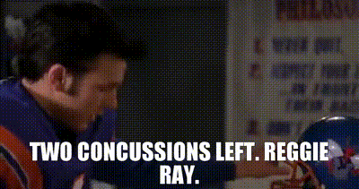
Magic Number

Slide 75
Learning Objectives
Explain the common network disruptions common after concussion
Identify the most common myths about concussion
Analyze recent research on the efficacy of minimum visits on concussion treatment with just a concussion specialist

Slide 76
Contact Info:
Website: cazeinstitute.com
Email: todd.caze@cazeinstitute.com
Cell: 480-296-8847
Scheduling: 402-235-8086
Social Media: Linkedin, Facebook, IG, Twitter, Tik Tok

