Slide 1
Drug and Alcohol
Testing
Notes:
1

Slide 2
What can be tested for
Alcohol - THC - Cocaine Amphetmines - Methamphetamines Barbiturates - Opioids Benzodiazepines - PCP - Methadone Ecastasy……
Just to name a few

Slide 3
SAMHSA estimates that around
70% of people with a SUD are currently employed

Slide 4
Do you really need to drug test…This is Neberaska!
Drug use by % of population who have used
Marijuana…..66.2
Cocaine…..22.2
Meth…..14.0
According to American Addiction Centers 5-5-2023

Slide 5
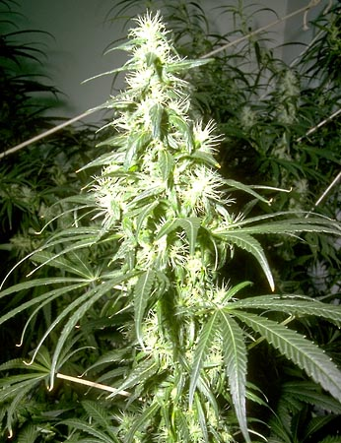
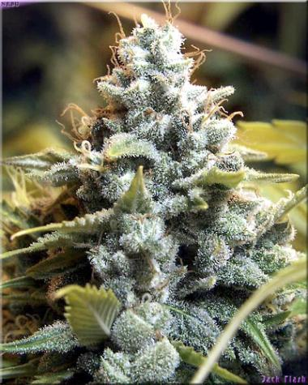
1974 – 1% THC level
Today – more than 17%

Slide 6
A National Safety Council survey revealed one third of employees have seen cannabis use during work hours.

Slide 7
What does it cost up front?
Cost of test
Time of the employee
Decreased labor pool.
May lengthen start times

Slide 8
What does it cost the bottom line?
Alcohol and drug use cost US companies -between 70-80 billion dollars each year in increased insurance, healthcare, and lowered productivity and attendance costs.
Drug and alcohol abuse in the workplace accounts for 65% of on-the-job accidents.
38% to 50% of all workers' compensation claims are related to the abuse of alcohol or drugs in the workplace.

Slide 9
Drug Effects
Slow reactions
Poor coordination
Fatigue
Delayed decision making
Confusion
Learning difficulty
Poor memory
Loss of concentration
Depression or anxiety
Erratic judgment quality
Refusal to accept authority

Slide 10
Workplace Issues and Alcohol
It takes 1 hour for an average person to process 1 serving of alcohol
Impairment in coordination and judgment can be measured with a BAC of .03
A person who is legally intoxicated BAC .08 is 6 times more likely to have an accident than a sober person

Slide 11
Saliva testing
June 1, 2023
DOT has approved saliva testing
September 1, 2023
There are no certified labs to conduct validity tests on saliva

Slide 12
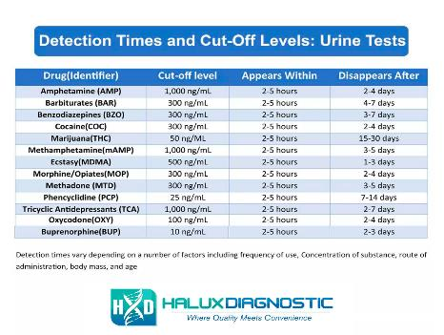
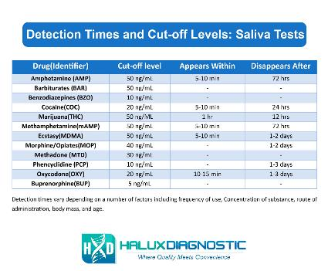
Urine VS Saliva

Slide 13

Can you pass a drug test?

Slide 14
